Slide 1
^{LINXON myRGA} ^{THEORY AND OPERATION}
Module 400: How to Communicate with the RGA
Notes:
Welcome to How to Communicate with the RGA.

Slide 2
^{PURPOSE}
Develop and demonstrate expertise with LINXON myRGA
Understand how myRGAs are connected to, and communicate with, computer systems.
Notes:
The purpose of this training module is to develop your expertise with LINXON myRGA.
Understanding how myRGAs are connected to, and communicate with, computer systems is important for understanding how to meet customer needs.

Slide 3
^{MAIN OBJECTIVES}
Identify IP address and subnetwork structure
Change a PCs IP address
Identify myRGA’s default IP address
Change myRGA’s IP Address
Notes:
In this module we will cover the following objectives:
Identify IP address and subnetwork structure
Change a PCs IP address
Identify myRGA’s default IP address
Change myRGA’s IP Address

Slide 4
^{OUTLINE}
1
Ethernet TCP/IP networking principles
Connecting myRGA to a network
Changing the RGA’s IP address
Changing the PC’s IP address
Network troubleshooting
2
3
4
5
Notes:
There are 6 sections in this module:
Ethernet TCP/IP networking principles
Connecting myRGA to a network
Changing the RGA’s IP address
Changing the PC’s IP address
Network troubleshooting

Slide 5
1
^{ETHERNET TCP/IP}
^{NETWORKING} ^{PRINCIPLES}
Notes:
5
Let’s begin with Section 1: Ethernet TCP/IP networking principles

Slide 6
^{IP ADDRESSES}
IP addresses are assigned to identify specific devices on a given network
Static IP Address vs. DHCP (Dynamic Host Communication Protocol)
Static IP Address (manually setting an IP address) is recommended
If the IP address changes then communication will be lost between the software and the RGA.
DHCP IP Address is automatically set by the host
IPv4 Addresses
Example 192.168.1.100
Notes:
myRGA uses Ethernet as its method of communication, and as with any network device this includes an IP address.
A Static IP Address is a dedicated specific IP Address for a given network device on a specific manually set network. All myRGA’s ship from the factory with a default IP address. Reserve a block of IP addresses for static use with myRGA. When installing myRGA you should request assistance from your IT department to find available IP addresses on your network.
DHCP (Dynamic Host Communication Protocol) means IP addresses for specific network devices are set automatically by the Host, but this is not recommended. This can lead to a loss of communication if the IP address is changed automatically.
myRGAs use IPv4 addresses, these consist of 4 decimal numbers each ranging from 0 to 255. For example 192.168.1.100

Slide 7
^{SUBNETWORKS}
Subnetworking is a method of logically dividing an IP network
IP Address – Unique identifier for each device
Subnet Mask – Determines the portion of the IP address that is the network prefix
Network Prefix – Same for all devices on a subnet
 | Example 1 | Example 2
IP address | 192.168.1.104 | 192.168.1.105
Subnet mask | 255.255.255.0 | 255.255.0.0
Network prefix | 192.168.1.0 | 192.168.0.0
Notes:
The act of splitting an IP network into multiple subnets is referred to as “subnetting”.
The IP address as discussed previously is a unique identifier for a network connected device.
Defining a subnet mask determines which part of the IP Address is used as the network prefix, as shown in this table.
For two network devices to communicate, they must be on the same subnet, they must have matching network prefixes.
For the table shown here, we have 2 IP addresses, 192.168.1.104 and 192.168.1.105. In example 1, the subnet mask is 255.255.255.0. This means the network prefix is 192.168.1.0. In example 2, the subnet mask is 255.255.0.0 which means that the network prefix is 192.168.0.0.

Slide 8
^{myRGA DEFAULT IP ADDRESS}
Factory Default IP Address
Every myRGA is shipped from the factory with a default IP address of:
192.168.1.100
Notes:
myRGA is shipped from our factory with the IP address set to be 192.168.1.100.
Therefore, depending on the network situation at the customer’s facility, this may need to be changed to be compatible with their existing network design.

Slide 9
2
^{CONNECTING myRGA TO A NETWORK}
Notes:
9
Section 2: Connecting myRGA to a network

Slide 10
^{CONNECTING myRGA TO A NETWORK}
There are a few questions you need to ask before starting with the connection process:
Upon which type of network will myRGA be installed?
Direct connection to a PC?
Local network?
Is more than one myRGA going to be set up at this time?
Notes:
When connecting myRGA to a network, you need to ask yourself two questions. Upon which type of network will myRGA be installed and is more than one myRGA going to be set up at this time?
For the first question, the type of network needs to be identified. For example will the RGA be installed with a direct wired Ethernet connection to the PC or will the RGA be connected to the same local network that the PC is on?
For the second question, identifying whether or not one or more RGA is to be installed is pertinent information as it will affect IP address assignments, and each RGA needs a unique static IP address to communicate. It can also have potential network design and setup implications.
We will explore a few different setup scenarios in the next few slides.

Slide 11
CONNECTING ONE RGA TO ONE COMPUTER
myRGA
Ethernet switch
PC
OR
myRGA
PC
Notes:
In this slide, we are looking at two different methods of a direct connection between one RGA to one PC. This can be achieved by connecting a myRGA to an Ethernet switch, and then to the PC.
Another way to connect myRGA, is to connect directly to a PC’s Ethernet port.
When connecting one myRGA to one computer, the RGA and the computer must have compatible network prefixes and be on the same subnet. This is true for both direct connections and for connections through an Ethernet switch.

Slide 12
^{CONNECTING A SINGLE RGA} ^{TO A LOCAL NETWORK}
myRGA
Ethernet switch
PC
Local network
Local network
Notes:
The diagram here shows connecting a single RGA to an existing local network. myRGA is connected to an Ethernet switch that is also connected to a local network. myRGA should now be available on PCs connected to the same local network.
When connecting a single RGA to an existing local network, the default IP address for myRGA may not be compatible with the existing network.
Routers can cause conflicts because they attempt to set the IP addresses of the network devices to which they are connected. This can lead to loss of connection. Therefore, it is recommended to use an Ethernet switch rather than a wireless router (as illustrated in the diagram).
The RGA may need to have its IP address changed to be compatible with the existing local network. We have already discussed one method of changing the IP address of the RGA, an additional method will be covered later in this module.

Slide 13
^{CONNECTING MULTIPLE RGAS} ^{TO ONE COMPUTER}
PC with one Ethernet (LAN) Port and an Ethernet Switch
myRGA
Ethernet Switch
PC
myRGA
-OR-
PC with multiple Ethernet (LAN) Ports
myRGA
PC
myRGA
Notes:
Connecting multiple RGAs to one computer is very similar to connecting one RGA to one computer. When connecting multiple RGAs while using a PC with one Ethernet port, you begin by connecting all myRGA units to an Ethernet switch, then connect myRGA to the PC.
Or, if you are using a PC with multiple Ethernet ports, you can connect multiple myRGA units, to the PC as long as the PC has enough Ethernet ports to support all of the connections.
When connecting multiple myRGAs to a single computer, the PC and the RGAs must have compatible network prefixes and must be on the same subnet.
Note that each RGA needs to have a unique IP address, or a network conflict will occur and communication will not be possible.

Slide 14
^{CONNECTING MULTIPLE RGAs} ^{TO A LOCAL NETWORK}
myRGA
Ethernet switch
PC
myRGA
Local network
Local network
Notes:
Connecting multiple myRGAs to a local network is very similar to connecting a single RGA to an existing local network. First myRGA units are connected to an Ethernet switch that is also connected to the local network. myRGA units should now be available on PCs connected to the same local network.
The RGAs may need to have their IP address changed to be compatible with the existing local network. We will address how to change the PC’s IP address, as well as, how to change the RGA’s IP address later in the chapter.
Note that each RGA needs to have a unique IP address, or else a network conflict will occur and communication will not be possible.

Slide 15
3
^{CHANGING THE RGA’S IP ADDRESS}
Notes:
15
Section 3: Changing the RGA’s IP address

Slide 16
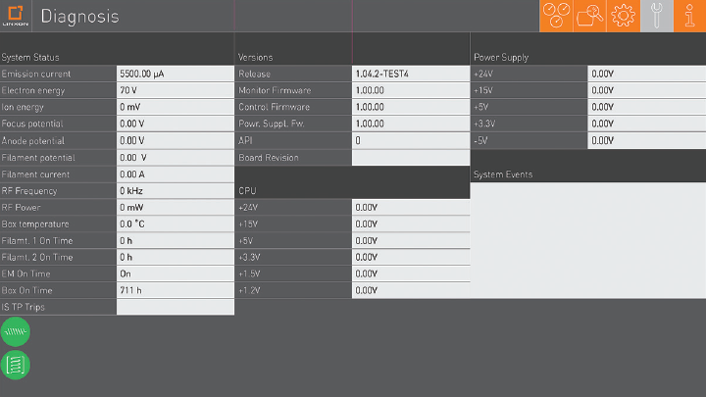
^{SETTING RGA IP ADDESS}
The onboard web server can be used to change the IP address of an RGA
Notes:
A tool that can be used to change the IP address of the RGA is called the onboard web server, which is included with every myRGA system. It can be used as a basic standalone RGA control option. It allows for basic data collection and the ability to save data. It can also serve as a diagnostic tool which provides specific information about the RGA, including firmware versions and other information.

Slide 17
4
^{CHANGING THE PC’S IP ADDRESS}
Notes:
17
Section 4: Changing the PC’s IP address

Slide 18
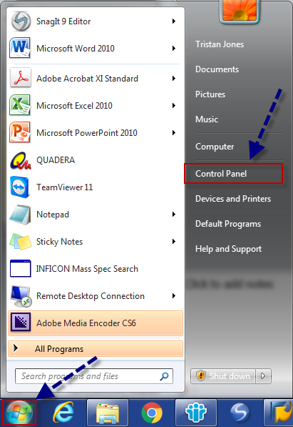
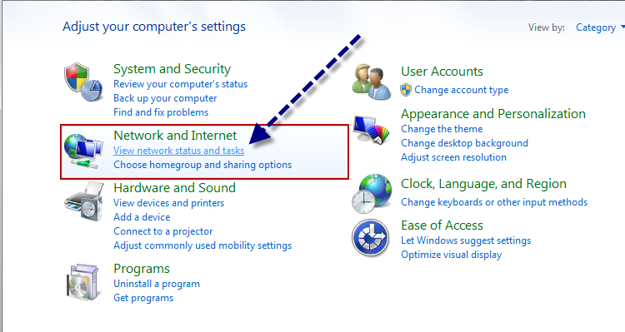
^{CHANGING THEPC’S IP ADDRESS}
To ensure the myRGA can properly communicate with the connected computer, the computer must have the correct network setup
Notes:
In some cases, the PC’s IP address may need to be changed to allow for proper communication, in addition to or instead of changing the RGA’s IP address.
Changing your PC’s IP address is very similar across different Windows software versions, the screenshots shown here are from Windows 7.
First, access the control panel.
Second, navigate to the Network and Internet section of the control panel.

Slide 19
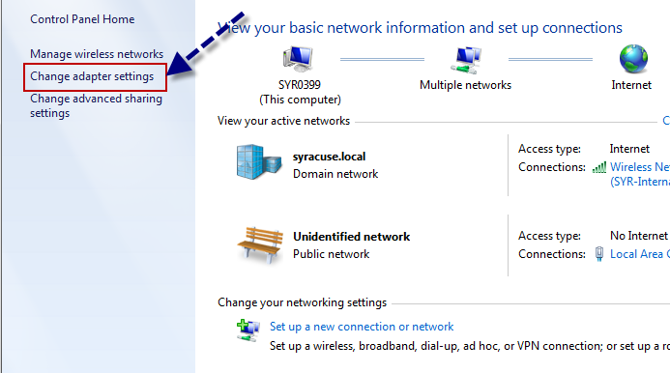
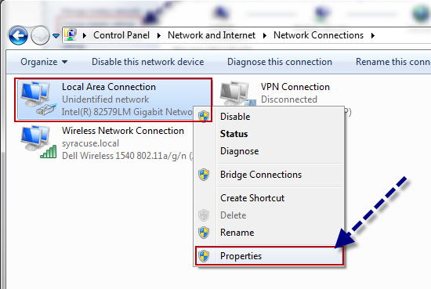
^{CHANGING THE PC’S IP ADDRESS}
Notes:
Next, choose change adapter settings.
Then, right click the local area connection, also known as the wired connection, and select properties.

Slide 20
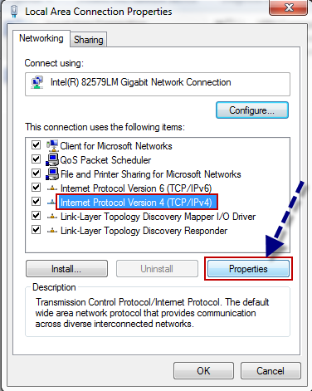
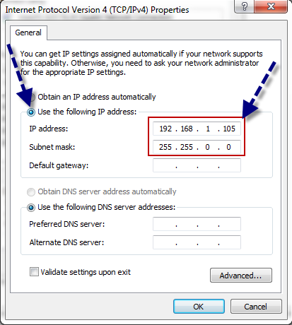
^{CHANGING THE PC’S IP ADDRESS}
Notes:
Next, choose the IPv4 option and select properties. Recall earlier it was mentioned that myRGAs utilize IPv4 IP addresses.
Then, choose the “Use the following IP address:” option and enter an IP Address and subnet mask that will allow the PC and RGA to be connected based on subnetworking which we already covered.

Slide 21
5
^{NETWORK TROUBLESHOOTING}
Notes:
21
Section 5: Network Troubleshooting

Slide 22
^{NETWORK TROUBLESHOOTING}
Ping RGA IP Address? | Onboard Web Server Com? | Suggested Steps
NO | N/A | Check the IP address of the myRGA and the PC to ensure compatibility
YES | NO | Check Firewall, Antivirus (port 80) permissions and Windows permissions (administrator privileges)
Notes:
The first step of network troubleshooting should always start with pinging the RGA’s IP address to establish that the network properties of the RGA and the PC are compatible. The second step is to try connecting to the onboard web server. Sometimes Windows and/or security settings can block the onboard web server from connecting.

Slide 23
^{SUMMARY}
Now that you have completed this module you should be able to;
Identify IP address and subnetwork structure
Change a PC’s IP address
Identify the myRGA default IP address
Change the myRGA IP address
Notes:
Now that you have completed this module you should be able to:
Identify IP address and subnetwork structure
Change a PC’s IP address
Identify the myRGA default IP address
Change the myRGA IP address

Slide 24
^{THANK YOU!}
You have completed the
RGA Hardware and How an RGA Works module!
You may come back and review
the content of this module at any time.
Notes:
Thank you.
You have completed the How to Communicate with the RGA module.
You may come back and review the content of this module at any time.

