Slide 1
^{LINXON myRGA} ^{THEORY AND OPERATION}
Module 100:
Gas Theory
Notes:
Welcome to RGA Theory and Operation, Gas Theory.

Slide 2
^{PURPOSE}
Develop expertise with LINXON myRGA
Understanding gas theory is an essential part of learning how RGAs work and how they can be used to meet customer needs
Notes:
The purpose of this training module is to develop your expertise with LINXON myRGA.
Understanding gas theory is an essential part of learning how RGAs work and how they can be used to meet customer needs.

Slide 3
^{OBJECTIVES}
Upon completion of this module, you will be able to:
List the subatomic particles that make up atoms
Describe how the mass of an atom is defined
Describe how the charge of a particle is defined
Describe that an ion is a charged particle
Describe the difference between the isotopes of an element
Describe the relationship between molecules and atoms
Describe the difference between partial and total pressure
Describe how gas concentration is defined
Notes:
Upon completion of this module, you will be able to:
List the subatomic particles that make up atoms
Describe how the mass of an atom is defined
Describe how the charge of a particle is defined
Describe that an ion is a charged particle
Describe the difference between the isotopes of an element
Describe the relationship between molecules and atoms
Describe the difference between partial and total pressure
Describe how gas concentration is defined

Slide 4
^{OUTLINE}
Three Basic States of Matter
Atoms and Subatomic Particles
Mass and Atomic Mass
Electric Charge and Ions
Elements, Atomic Number and Isotopes
Molecules
Total Pressure and Partial Pressure
Gas Concentration
Vacuum
1
2
3
4
5
6
7
8
9
Notes:
In this module, we will discuss:
Three Basic States of Matter, including Gas
Atoms and Subatomic Particles
Mass and Atomic Mass
Electric Charge and Ions
Elements, Atomic Number and Isotopes
Molecules
Total Pressure and Partial Pressure
Gas Concentration
Vacuum

Slide 5
1
^{THREE BASIC STATES OF MATTER}
Notes:
5
Let’s begin with Section 1: Three Basic States of Matter.

Slide 6
^{THREE BASIC STATES OF MATTER}
Solid, liquid and gas
Water, for example:
Solid form of water is “ice”
Liquid form of water is “liquid water” or “water”
Gas form of water is “water vapor” or “water”
State depends on temperature and pressure
A key difference is how freely the particles can move
Notes:
There are three basic states of matter. These are solid, liquid and gas.
Let’s consider water as an example. The solid form of water is ice. The liquid form of water is liquid water, usually called water. The gas form of water is often called water vapor, or water.
For all substances, including water, the state depends on both the temperature and the pressure.
A key difference between these states is how freely the particles of the substance can move.

Slide 7
^{SOLID}
Particles of a solid object are confined in their arrangement
A solid object will retain its shape
Example: steel chamber wall
Chamber
RGA
Steel chamber wall
Notes:
Particles of a solid object are confined in their arrangement. A solid object will retain its shape. One example of a solid object is a steel chamber wall.

Slide 8
^{LIQUID}
Particles of a liquid move more freely than a solid
Particles of a liquid can flow
They can move in relation to each other
Conform to the shape of a container
Example: isopropyl alcohol spill, flows to bottom of chamber
Chamber
RGA
Example: puddle of spilled liquid isopropyl alcohol
Notes:
The particles of a liquid move more freely than the particles of a solid. The particles of a liquid can flow. They can move in relation to each other. Liquid will conform to the shape of a container. For example, a large amount of isopropyl alcohol, spilled into a chamber, could flow to form a puddle at the bottom of the chamber.

Slide 9
^{GAS}
Gas particles move more freely than a solid or a liquid
Gas spreads to fill the available space or chamber
Spreading process, called diffusion, produces a uniform distribution of the gas
Example: Alcohol gas diffuses throughout the chamber
Chamber
RGA
Gas diffuses uniformly throughout the chamber
Notes:
Let’s consider the third state of matter, gas. Gas particles move more freely than particles of either a solid or a liquid.
Gas particles have so much freedom to move that they spread to fill the available space or chamber.
This spreading process is called diffusion. It tends to produce a uniform distribution of gas throughout the enclosed volume or chamber.
In this example, alcohol gas diffuses throughout the volume to form a uniform distribution.

Slide 10
GAS NUMBERS ARE SMALL AND NUMEROUS
Extremely small size
Can be present in tremendously high quantities
Could be more than one billion trillion gas particles in a chamber
Measured sample can represent gas content of chamber
Chamber
Large number of extremely small gas particles
RGA
Notes:
Gas particles are extremely small in size. They can be present in tremendously high quantities.
There could be more than one billion trillion gas particles in a chamber.
They spread by diffusion to form a uniform distribution. This is important for RGA applications. Because of diffusion, a measured sample can represent the gas content of the chamber. However, this is a simplified example. In some cases, the gas might not have the opportunity to diffuse uniformly throughout the chamber. In such cases, additional care should be taken regarding sensor location and data interpretation.

Slide 11
^{GAS - A MIXTURE OF GASES}
Any volume of gas is a mixture of different gases
For example, air is a mixture of:
Nitrogen
Oxygen
Argon
Water
Other gases in trace amounts
Each gas in a mixture will diffuse to produce a uniform distribution
Gas intended to be pure typically will contain impurities
Notes:
Any volume of gas is a mixture of different gases.
For example, air is a mixture of nitrogen, oxygen, argon, water and other gases in trace amounts.
Each gas in a mixture will diffuse evenly throughout the chamber to produce a uniform distribution of all gases present.
Gas that is intended to be pure typically will contain some impurities. It is difficult, or nearly impossible, to sustain a 100% pure volume of gas.

Slide 12
2
^{ATOMS AND SUBATOMIC PARTICLES}
Notes:
12
Section 2: Atoms and Subatomic Particles

Slide 13
^{ATOMS}
Atoms are the particles that comprise all matter, including solids, liquids and gases
Extremely small particles
Highly abundant – present in tremendously high quantities
A 1 carat diamond, 1/5 gram of carbon, is comprised of 1 x 10²² carbon atoms, or ten billion trillion atoms
A 25 liter chamber containing argon gas at room temperature and 1 Torr pressure, contains approximately 1 x 10²¹ atoms, or one billion trillion atoms
Notes:
Atoms are the particles that comprise all matter, including solids, liquids and gases.
Atoms are extremely small particles. Individual atoms cannot be seen with the unaided eye.
Because atoms are so small, they are present in tremendously high quantities.
For example, a 1 carat diamond is 1/5 (one-fifth) of a gram of carbon. It is comprised of 1 x 10²² carbon atoms. That is ten billion trillion carbon atoms.
As an example for gas, a 25 liter chamber containing argon gas at room temperature and 1 Torr pressure, contains approximately 1 x 10²¹ atoms, or one billion trillion argon atoms.

Slide 14
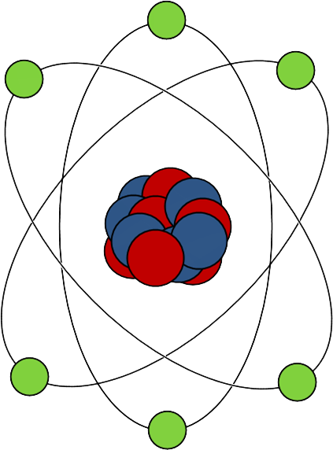
^{SUBATOMIC PARTICLES}
Atoms are made of subatomic particles
Protons and neutrons – in the nucleus
Electrons – in the electron cloud
Electron cloud: electrons
Nucleus: protons and neutrons
Notes:
Atoms are made of subatomic particles. These particles are known as protons, neutrons and electrons.
Protons and neutrons are at the center of the atom, in the nucleus of the atom.
Electrons are in the electron cloud that surrounds the atom.
This diagram shows the basic concept of atomic structure. It is not drawn to scale.

Slide 15
^{MASS AND ATOMIC MASS}
3
Notes:
15
Section 3: Mass and Atomic Mass

Slide 16
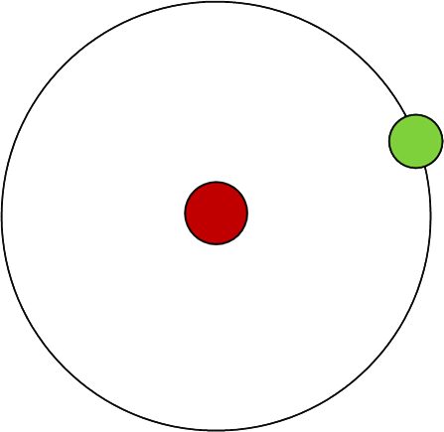
^{MASS -} ^{AMOUNT OF MATERIAL}
Mass is a physical property of an object
A measure of the amount of material
More material will exhibit more mass
Mass spectrometers identify different gases according to mass
Hydrogen atom,
less mass
Carbon atom, more mass
Notes:
Mass is a physical property of an object. It is a measure of the amount of material that makes up an object.
The diagram on the left represents a hydrogen atom. The diagram on the right represents a carbon atom. These figures are not drawn to scale.
The carbon atom has more material, more protons and neutrons in its nucleus, so it has more mass.
RGA mass spectrometers identify different gases according to the masses of the gas particles.
The next three slides will describe three more physical characteristics that are related to mass. These are weight, inertia and resonant frequency.

Slide 17
^{MASS AND WEIGHT}
Mass and weight are related, yet not the same
Mass is the amount of material
Weight is the force of gravity attracting that material
The greater the mass, the greater its weight
Mass
Weight
(force due to gravity)
Earth
Notes:
Mass and weight are related to each other, yet they are not the same.
Mass is the amount of material in an object.
Weight is the force of gravity attracting that material.
The greater the mass of an object, the greater its weight.

Slide 18
^{MASS AND INTERTIA}
Inertia is an object’s resistance to change of motion due to a force
A mass will not change velocity until a force is applied
A mass at rest will remain at rest until a force is applied
A mass in motion will move at constant speed and direction until a force is applied
An object’s inertia is proportional to its mass
An object with more mass requires more force to change its motion
m
Path with no force applied
Object (mass) moving to the right
Path with force applied down, amount of deflection depends on mass (inertia)
Notes:
Another key property of mass is inertia, an object’s resistance to change of motion due to a force.
A mass will not change velocity until a force is applied. Specifically, a mass at rest will remain at rest until a force is applied, and a mass in motion will move at constant speed and direction until a force is applied.
An object’s inertia is proportional to its mass.
This means that an object with more mass requires more force to change its motion. Also, for a specific amount of force, an object with greater mass will experience less change in motion than an object with less mass.
As an example of inertia, the blue circle in this diagram represents an object, a mass, moving to the right at constant velocity. If there is no force applied to the mass, it will continue to move at constant velocity, which means constant speed and direction, a straight line to the right. Its speed or direction will only change when a force is applied to the object. For example, if a downward force is applied to the mass, it will change velocity by changing direction. Rather than moving in a straight line, its path will curve downward due to the force.

Slide 19
^{MASS AND RESONANT FREQUENCY}
Different physical systems have different resonant frequencies
Frequency at which a system or object will oscillate or vibrate
In many systems, mass affects resonant frequency
Piano string example
The mass of a piano string is one of the factors that determines its frequency, the pitch of the note
Mass spectrometer example
An ion’s mass is one of the factors that determines if that ion will resonate to pass through a mass filter
Notes:
Different physical systems have different resonant frequencies. Another term for this behavior is natural frequency, the frequency at which a system or object will oscillate.
In many of these systems, mass affects the resonant frequency.
Let’s consider a piano string as an example. The mass of a piano string is one of the factors that determines its frequency, the pitch of the note.
A mass spectrometer is another example of mass affecting resonant frequency.
An ion’s mass is one of the factors that determines if that ion will resonate to pass through a mass filter.
In summary, we have reviewed four physical characteristics related to mass. These are the amount of material, weight, inertia, and resonant frequency.

Slide 20
^{MASS AND SUBATOMIC PARTICLES –} ^{ATOMIC MASS UNIT}
The atomic mass unit (amu or u)
1 amu = mass of either 1 proton or 1 neutron
1 amu = 1.66 x 10⁻²⁷ kg
Proton and Neutron
 | Mass
Proton | 1 amu
Neutron | 1 amu
Electron
 | Mass
Electron | 0 amu
Notes:
The masses of atoms and subatomic particles are measured in atomic mass units. The symbols used to express atomic mass units are either amu or u.
For the purpose of RGA theory and application, 1 amu is equal to the mass of either 1 proton or 1 neutron.
1 amu is equal to 1.66 x 10⁻²⁷ kg, an extremely small amount of mass.
Because it is easier to work with integers rather than decimals and exponents, we use amu instead of kilograms for atomic mass.
These tables summarize the masses of the subatomic particles.
A proton has a mass of 1 amu.
A neutron has a mass of 1 amu.
An electron has approximately zero mass, or 0 amu.

Slide 21
^{ATOMIC MASS}
Atomic mass is the mass of an atom
Unit of measure is the atomic mass unit (amu or u)
Equal to the total number of protons and neutrons in the atom
For example, carbon-12 atom:
6 protons and 6 neutrons
6 + 6 = 12
Atomic mass is 12 amu
Notes:
Atomic mass is the mass of an atom.
The unit of measure for atomic mass is the atomic mass unit, shown by the unit symbol amu, or u.
The mass of an atom, in atomic mass units, is equal to the total number of protons and neutrons in the atom.
For example, a carbon-12 atom has 6 protons and 6 neutrons. The atomic mass for carbon-12 is 12 amu.

Slide 22
^{MASS NUMBER}
Mass number is equal to atomic mass, except that mass number is shown with no unit of measure (dimensionless)
For example, carbon-12 atom:
Atomic mass is 12 amu
Mass number is 12
Notes:
Mass number is equal to atomic mass, except that mass number is shown with no unit of measure.
Having no unit of measure is referred to as being dimensionless.
Using a carbon-12 atom as our example, the atomic mass of carbon-12 is 12 amu. Its mass number is 12.

Slide 23
4
^{ELECTRIC CHARGE AND IONS}
Notes:
23
Section 4: Electric Charge and Ions

Slide 24
^{ELECTRIC CHARGE}
Positive, negative or zero (neutral)
Opposite charges, positive and negative, attract one another
Charges of the same sign, positive and positive, for example, repel one another
Notes:
The electric charge of an object can be positive, negative, or zero also referred to as neutral.
Opposite charges, positive and negative, attract one another. Each experiences a force that is directed toward the other.
Charges of the same sign, positive and positive for example, repel one another. Each experiences a force that is directed away from the other.

Slide 25
^{ELECTRIC CHARGE OF} ^{SUBATOMIC PARTICLES}
The elementary charge unit (e) is defined as the magnitude of the electric charge of 1 electron
Electrons have negative charge, protons have positive charge
An electron has 1 unit of negative charge (-1 e)
A proton has 1 unit of positive charge (+1 e)
Neutrons are neutral
1 e = 1.6 x 10⁻¹⁹ C
1 Ampere is a stream of 6 billion billion electrons per second
Electron
-1 e
Proton
+1 e
Hydrogen atom
Notes:
The elementary charge unit (abbreviated as the letter e) is defined as the magnitude of the electric charge of 1 electron.
Electrons have negative charge. Protons have the same magnitude of positive charge.
An electron has 1 unit of negative charge, -1 e.
A proton has 1 unit of positive charge, +1 e.
Neutrons are neutral, they have zero charge.
1 elementary charge is equal to 1.6 x 10⁻¹⁹ Coulombs.
This means there are 6 x 10¹⁸ electrons per Coulomb of charge.
This also means that 1 Ampere of electrical current, 1 Coulomb per second, is a stream of 6 billion billion electrons per second, or 6 quintillion electrons per second.

Slide 26
^{ELECTRIC CHARGE OF} ^{SUBATOMIC PARTICLES}
Proton and Neutron
 | Mass | Charge
Proton | 1 amu | +1 e
Neutron | 1 amu | 0 e
Electron
 | Mass | Charge
Electron | 0 amu | -1 e
Notes:
The top table summarizes the mass and charge values for the proton and the neutron.
A proton has a mass of 1 amu and a charge of positive 1 e.
A neutron has a mass of 1 amu and neutral charge.
The bottom table summarizes the mass and charge values for the electron.
An electron has approximately zero mass and a charge of negative 1 e.

Slide 27
^{NET CHARGE OF A PARTICLE}
Net charge is the sum of the electric charges
Protons are positive (+1 e)
Electrons are negative (-1 e)
Neutrons are neutral (0)
Particle’s net charge is equal to number of protons minus number of electrons
When number of protons and number of electrons are equal, net charge is neutral
Atoms are neutral
Atoms have equal numbers of protons and electrons
Notes:
Net charge is the sum of the electric charges.
Protons are positive, electrons are negative, and neutrons are neutral.
A particle’s net charge is equal to the number of protons minus the number of electrons in the particle.
When the number of protons and the number of electrons are equal, the net charge is neutral or zero.
Atoms are neutral. Atoms have equal numbers of protons and electrons.

Slide 28
^{CHARGE NUMBER (z)}
Charge number is equal to the net charge of a particle shown with no unit of measure (dimensionless)
Charge number is a dimensionless integer
-2, -1, 0, 1, 2,…
Commonly used to show the charge of a particle
Simplifies the units displayed for mass-to-charge ratio
Mass-to-charge ratio = mass divided by charge (or charge number)
Allows display of mass-to-charge ratio in units of amu, as an alternative to amu/e
Integer value is not affected
Convenient option to simplify the display of measurement units
Notes:
Charge number, indicated by the letter z, is equal to the net charge of a particle shown with no unit of measure, or dimensionless.
Charge number is a dimensionless integer, such as -2, -1, 0, 1, 2, and so on.
Charge number is commonly used to show the charge of a particle.
This simplifies the units displayed for a commonly used parameter known as mass-to-charge ratio.
Mass-to-charge ratio is equal to a particle’s mass divided by its charge, or charge number.
Using charge number allows us to display mass-to-charge ratio in units of amu as an alternative to amu/e.
The integer value is not affected. Using charge number is a convenient option to simplify the display of measurement units.

Slide 29
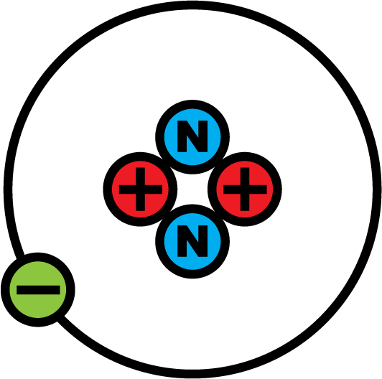
^{ION – A CHARGED PARTICLE}
An ion is a particle with a net charge not equal to zero (not neutral)
Atom loses 1 electron
Loses 1 unit of negative charge
Becomes a positive ion with a charge of +1 e
Atom loses 2 electrons
Loses 2 units of negative charge
Becomes a doubly ionized positive ion with a charge of +2 e
Often show charge as a charge number
Show integer value without the unit symbol e
Still commonly called charge
Helium ion (He⁺)
Notes:
An ion is a particle with a net charge that is not equal to zero, it is not electrically neutral.
If an atom loses 1 electron, then it loses 1 unit of negative charge. It becomes a positive ion with a charge of positive 1 e.
In cases where an atom loses 2 electrons, it loses 2 units of negative charge. It becomes a doubly ionized positive ion with a charge of positive 2 e.
Often we show charge as a charge number. This is done for convenience by showing the integer value without the unit symbol e. The charge number still is commonly called charge.

Slide 30
^{ELEMENTS, ATOMIC NUMBER,}
^{AND ISOTOPES}
5
Notes:
30
Section 5: Elements, Atomic Number and Isotopes

Slide 31
^{ELEMENTS}
Elements are different types of atoms
More than 100 known elements
Organized in the Periodic Table of Elements
Some elements have similar properties
For example: copper, silver and gold
Soft metals, good electrical conductors, relatively inert
Some elements have very different properties
For example: helium and chlorine
Helium: odorless, inert, non-toxic
Chlorine: strong odor, highly reactive, poisonous
Notes:
Elements are different types of atoms. There are more than 100 known elements. They are organized in the Periodic Table of Elements.
Some elements have similar properties. For example, copper, silver and gold have similar properties. They are soft metals. They are good electrical conductors. Chemically, they are relatively inert.
Some elements have very different properties. For example, helium and chlorine. Helium is odorless, inert, and non-toxic. Chlorine has a strong odor, is highly reactive, and is poisonous.

Slide 32
^{ATOMIC NUMBER}
Atomic number is the number of protons in the nucleus of an atom
Characteristic that defines each chemical element
All atoms of an element have the same number of protons (atomic number)
Carbon has 6 protons, atomic number 6
Nitrogen has 7 protons, atomic number 7
Oxygen has 8 protons, atomic number 8
Chemical properties of elements depend on atomic number
Chemical properties of atoms depend on the number of electrons they contain
Atoms are neutral, so atomic number indicates:
Number of protons
Equivalent number of electrons
Chemical properties of the element due to that number of electrons
Notes:
Atomic number is the number of protons in the nucleus of an atom.
It is the characteristic that defines each chemical element.
All atoms of a particular element have the same number of protons, or the same atomic number.
Carbon has 6 protons, for an atomic number of 6. Nitrogen has 7 protons for an atomic number of 7. Oxygen has 8 protons for an atomic number of 8, and so on.
The chemical properties of elements depend on atomic number.
The reason is because the chemical properties of atoms depend on the number of electrons they contain.
Atoms are neutral, so atomic number indicates the number of protons, the equivalent number of electrons, and therefore the chemical properties of the element due to that number of electrons.

Slide 33
ATOMIC NUMBER – DIFFERENT FROM ATOMIC MASS AND MASS NUMBER
Atomic number
Number of protons
Defines each element in the Periodic Table
Chemical properties of the elements depend on atomic number
Atomic mass
Total number of protons and neutrons
Units of amu
Basis for an RGA (mass spectrometer) to independently measure different gases
Mass number is the same as atomic mass, just shown with no unit of measure
Notes:
Let’s review and contrast atomic number and atomic mass.
Atomic number is different from atomic mass. Atomic number also is different from mass number.
Atomic number is the number of protons in the atom.
It defines each element in the Periodic Table.
The chemical properties of the elements depend on atomic number.
In contrast, atomic mass is the total number of protons and neutrons in the atom.
It typically is measured in units of amu.
It is the basis for an RGA, a mass spectrometer, to independently measure different gases.
Mass number is the same as atomic mass, just shown with no unit of measure.

Slide 34
^{HYDROGEN-1 ATOM} ^{(PROTIUM)}
Atomic number: 1
1 proton
Atomic mass: 1 amu
1 proton, 0 neutrons
Charge: neutral
Atom
1 proton, 1 electron
Electron
Proton
Notes:
This example is a hydrogen-1 atom, also known as protium. Its atomic number is 1 because there is 1 proton in the nucleus. Its atomic mass is 1 amu because it contains 1 proton and zero neutrons. Its charge is neutral because it is an atom, it has an equal number of protons and electrons, 1 of each.

Slide 35
^{CARBON-12 ATOM}
Atomic number: 6
6 protons (red)
Atomic mass: 12 amu
6 protons, 6 neutrons (blue)
Charge is neutral
Atom
6 protons, 6 electrons (green)
Notes:
This example is a carbon-12 atom. Its atomic number is 6 because there are 6 protons in the nucleus. Its atomic mass is 12 amu because it contains 6 protons and 6 neutrons. Its charge is neutral because it is an atom, it has an equal number of protons and electrons, 6 of each.

Slide 36
^{ISOTOPES}
Atoms of the same element that have different masses
Same element, same number of protons
Different masses, different numbers of neutrons
Same chemical properties, same number of electrons
Argon example
Argon Isotope | Mass | Protons | Neutrons
Argon-40 | 40 | 18 | 22
Argon-38 | 38 | 18 | 20
Argon-36 | 36 | 18 | 18
Notes:
Isotopes are atoms of the same element that have different masses.
Because they are the same element, they have the same number of protons.
Isotopes have different masses because they have different numbers of neutrons.
Isotopes of an element have the same chemical properties because they have the same number of electrons.
This table shows the three most abundant isotopes of argon, listed in order of mass, argon-40, argon-38 and argon-36.
All argon atoms have 18 protons. The atomic masses are different according to the different numbers of neutrons.

Slide 37
^{ISOTOPE RELATIVE ABUNDANCE}
Each isotope has its own natural relative abundance
Carbon and argon isotope abundances are listed below
Isotope | Abundance
Carbon-12 | 98.90%
Carbon-13 | 1.10%
Carbon-14 | <0.01%
Isotope | Abundance
Argon-40 | 99.60%
Argon-36 | 0.34%
Argon-38 | 0.06%
Notes:
Each isotope has its own natural relative abundance on Earth.
The table on the left lists carbon isotope abundance.
98.9% of carbon atoms on Earth are carbon-12.
1.1% are carbon-13, and a small fraction of a percent are carbon-14.
The table on the right lists argon isotope abundance.
99.6% of argon atoms on Earth are argon-40.
0.34% are argon-36, and 0.06% are argon-38.

Slide 38
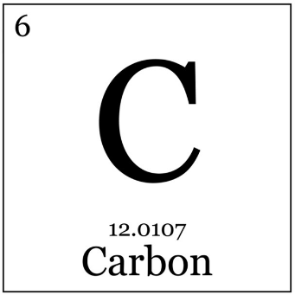
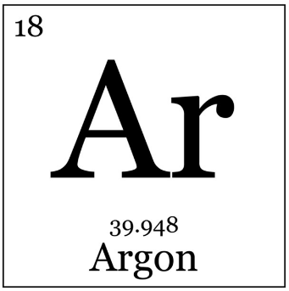
^{PERIODIC TABLE OF ELEMENTS}
Each element’s name, symbol, atomic number and average mass
Average mass is the weighted-average per the isotope abundance
Elements listed on Periodic Table by ascending atomic numbers
Atomic Number
Symbol
Average Atomic Mass
Name
Notes:
The Periodic Table of Elements organizes and displays the elements in a logical and effective manner.
Each element’s name, symbol, atomic number and average mass are displayed on the table. The average mass is the weighted-average, based on the element’s isotope abundance.
The elements are listed on the Periodic Table by ascending atomic numbers.

Slide 39
6
^{MOLECULES}
Notes:
39
Section 6: Molecules

Slide 40
^{WHAT IS A MOLECULE?}
A particle comprised of two or more atoms that are bonded together
Structures that are larger than individual atoms
Examples of molecules:
Oxygen (O₂)
Isopropyl alcohol (C₃H₇OH)
Mass of a molecule is the total number of protons and neutrons
Electric charge of a molecule is neutral
Gases can be comprised of atoms and molecules
Notes:
A molecule is a particle that is comprised of two or more atoms that are bonded together.
Molecules form structures that are larger than individual atoms.
Examples of molecules include oxygen and isopropyl alcohol. Oxygen is a molecule formed by two oxygen atoms bonded together.
Isopropyl alcohol is a larger molecule made of carbon, hydrogen and oxygen.
The mass of a molecule is the total number of protons and neutrons in the molecule, measured in amu.
The electric charge of a molecule is neutral. If a molecule acquires a net charge, then it becomes an ion.
Gases can be comprised of atoms and molecules.

Slide 41
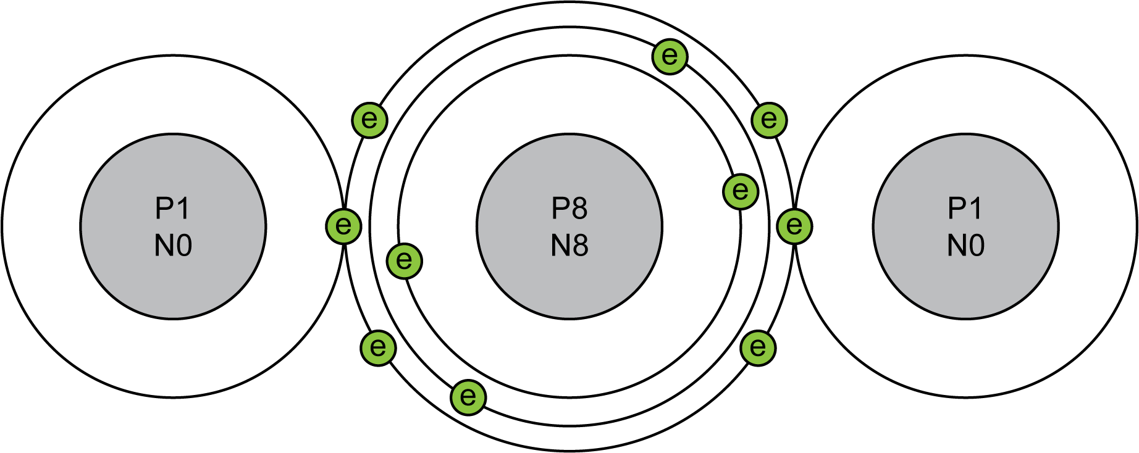
^{WATER MOLECULE}
Water example: 2 hydrogen atoms bonded to 1 oxygen atom
Chemical formula H₂O
Mass is 18 amu (10 protons plus 8 neutrons)
Hydrogen
Hydrogen
Oxygen
Notes:
Water, for example, is formed by 2 hydrogen atoms bonded to 1 oxygen atom.
The chemical formula is H₂O.
Water has a mass of 18 amu because it has 10 protons and 8 neutrons. Each hydrogen atom contributes 1 proton, and the oxygen atom contributes 8 protons and 8 neutrons.

Slide 42
^{IONS FORMED FROM MOLECULES}
Ions can be formed from molecules
Similar to how ions are formed from atoms
When a molecule acquires a net charge, it becomes an ion
Molecule loses 1 electron:
Loses 1 unit of negative charge
Becomes a positive ion with a charge of +1
Molecule loses 2 electrons:
Loses 2 units of negative charge
Becomes a doubly ionized positive ion with a charge of +2
Notes:
Ions can be formed from molecules. This is similar to how ions are formed from atoms.
Molecules are neutral. When a molecule acquires a net charge, it becomes an ion.
A molecule that gets ionized, or loses 1 electron, loses 1 unit of negative charge. It becomes a positive ion with a charge of +1.
A molecule that gets doubly ionized, or loses 2 electrons, loses 2 units of negative charge. It becomes a doubly ionized positive ion with a charge of +2.

Slide 43
7
^{TOTAL PRESSURE}
^{AND PARTIAL PRESSURE}
Notes:
43
Section 7: Total Pressure and Partial Pressure

Slide 44
GAS PRESSURE – FORCE PER UNIT AREA
Gas pressure is the force per unit area that gas exerts on the walls or surfaces of its container
Units of measure for pressure include:
Pounds per square inch (psi)
Newtons per square meter (N/m²), equal to Pascal (Pa)
Atmosphere (atm)
Bar
Torr
Force
Area
Notes:
Gas pressure is the force per unit area that a gas exerts on the walls or surfaces of its container.
Units of measure for pressure include:
Pounds per square inch
Newtons per square meter, which are equal to Pascal
Atmosphere
Bar
and Torr.
While pressure is defined as force per unit area, it also indicates the amount of gas in the chamber.

Slide 45
^{GAS PRESSURE – AMOUNT OF GAS}
Gas Pressure (P)
Proportional to the number of gas molecules in a chamber (n)
Proportional to the temperature of the gas (T)
Inversely proportional to the volume of the chamber (V)
When temperature and volume are constant, the pressure is proportional to the amount of gas (P ∝ n)
Gas pressure indicates the amount of gas in the chamber
$$P∝\frac{nT}{V}$$
Notes:
The relationship between gas pressure and the amount of gas is shown in this expression of proportionality.
Gas Pressure (P) is proportional to the number of gas molecules in a chamber (n).
It is proportional to the temperature of the gas (T), and is inversely proportional to the volume of the chamber (V).
When temperature and volume are constant, which often is the case, the pressure is proportional to the amount of gas.
In this case, a change in pressure indicates a change in the amount of gas. Therefore, when volume and temperature are constant, gas pressure indicates the amount of gas in the chamber.

Slide 46
^{TOTAL PRESSURE}
Total pressure is the pressure that a gas mixture, the total gas, exerts on the walls of a chamber
A variety of pressure gauges are available, including:
Capacitance diaphragm gauge (CDG)
Cold cathode ionization gauge
Hot cathode ionization gauge
Pirani (thermal conductivity) gauge
All gases
Area
Notes:
Total pressure is the pressure that a gas mixture, the total gas, exerts on the walls of a chamber.
A pressure gauge is used to measure total pressure. A variety of pressure gauges are available, including capacitance diaphragm gauge (CDG), cold cathode ionization gauge, hot cathode ionization gauge, and Pirani (thermal conductivity) gauge.

Slide 47
^{PARTIAL PRESSURE}
Pressure that one gas species in a mixture would exert if it was the only gas in the chamber
Partial pressure of each gas species is proportional to the amount of that gas species
Partial pressure is used to independently analyze gas species
RGAs can measure gas species separately, so RGAs are used to measure partial pressure
N₂
O₂
Ar
Area
Notes:
Partial pressure is the pressure that one gas species in a mixture would exert on the chamber walls if it was the only gas present in the chamber.
The higher the partial pressure, the higher the amount of that gas in the chamber.
Partial pressure is used to independently analyze one, or more, gas species.
RGAs can measure gas species separately, so RGAs are used to measure partial pressure.

Slide 48
TOTAL PRESSURE AND PARTIAL PRESSURE
Total pressure is equal to the sum of the partial pressures
Adding the partial pressures of all gases present will equal the total pressure
100 mTorr of air comprised of:
78 mTorr nitrogen (78%)
21 mTorr oxygen (21%)
1 mTorr argon (1%)
Other gases (< 1%)
100 mTorr total
78 mTorr nitrogen
Pressure
21 mTorr oxygen
1 mTorr argon
Notes:
Total pressure is equal to the sum of the partial pressures present in a chamber.
Adding the partial pressures of all gases present will equal the total pressure.
For example, 100 mTorr of air is comprised of 78 mTorr of nitrogen, 21 mTorr of oxygen, 1 mTorr of argon, and trace amounts of other gases.

Slide 49
8
^{GAS CONNECTION}
Notes:
49
Section 8: Gas Concentration

Slide 50
^{GAS CONNECTION}
Concentration is a ratio
Gas concentration ratio = partial pressure divided by total pressure
A measurement of the amount of one gas species with respect to the total amount of gas present
Calculating concentration in three units of measure
Percent: Multiply ratio times 100 (%)
Parts per million: Multiply ratio times 1,000,000 (ppm)
Parts per billion: Multiply ratio times 1,000,000,000 (ppb)
Example for concentration, in units of ppm
Concentration = (Partial Pressure / Total Pressure) x 1,000,000 ppm
Notes:
Concentration is a ratio.
Gas concentration is equal to partial pressure divided by total pressure.
It is a measurement of the amount of one gas species with respect to the total amount of gas present.
Concentration typically is calculated into one of three common units of measure, percent, ppm, or ppb.
For units of percent, multiply the ratio times 100 and show the percent symbol (%).
For parts per million, multiply the ratio times 1,000,000 and show ppm as the measurement unit.
For parts per billion, multiply the ratio times 1,000,000,000 and show ppb as the measurement unit.
Here is an example of how you can measure and calculate concentrations, in units of ppm.
Measure both the partial pressure of one gas species and the total pressure of the gases present.
Divide the partial pressure by the total pressure.
Then multiply by one million (1,000,000) and show ppm as the measurement unit.

Slide 51
9
^{VACUUM}
Notes:
51
Section 9: Vacuum

Slide 52
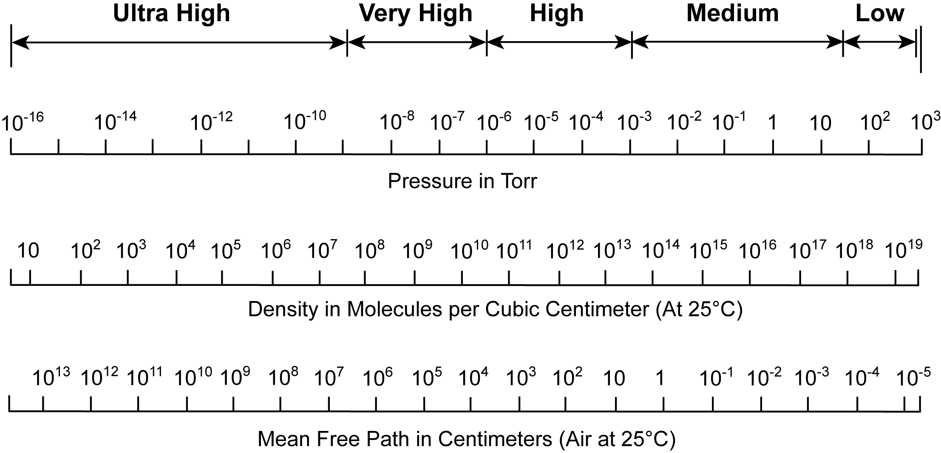
^{VACUUM}
Gas pressure that is less than the pressure of the local ambient atmosphere
Harland G. Tompkins; An introduction to the Fundamentals of Vacuum Technology, 1984
Notes:
Vacuum is a gas pressure that is less than the pressure of the local ambient atmosphere. The different ranges of vacuum are called low, medium, high, very high and ultra high. This chart, from Tompkins, shows the corresponding ranges of gas pressure, gas density, and mean free path for these named vacuum ranges. Mean free path is the average distance that a particle will travel before colliding with, or interacting with, another particle.

Slide 53
^{THANK YOU!}
You have completed the
Gas Theory module!
You may come back and review
the content of this module at any time.
Notes:
Thank you.
You have completed the Gas Theory module.
You may come back and review the content of this module at any time.

